Slide 1


Slide 2
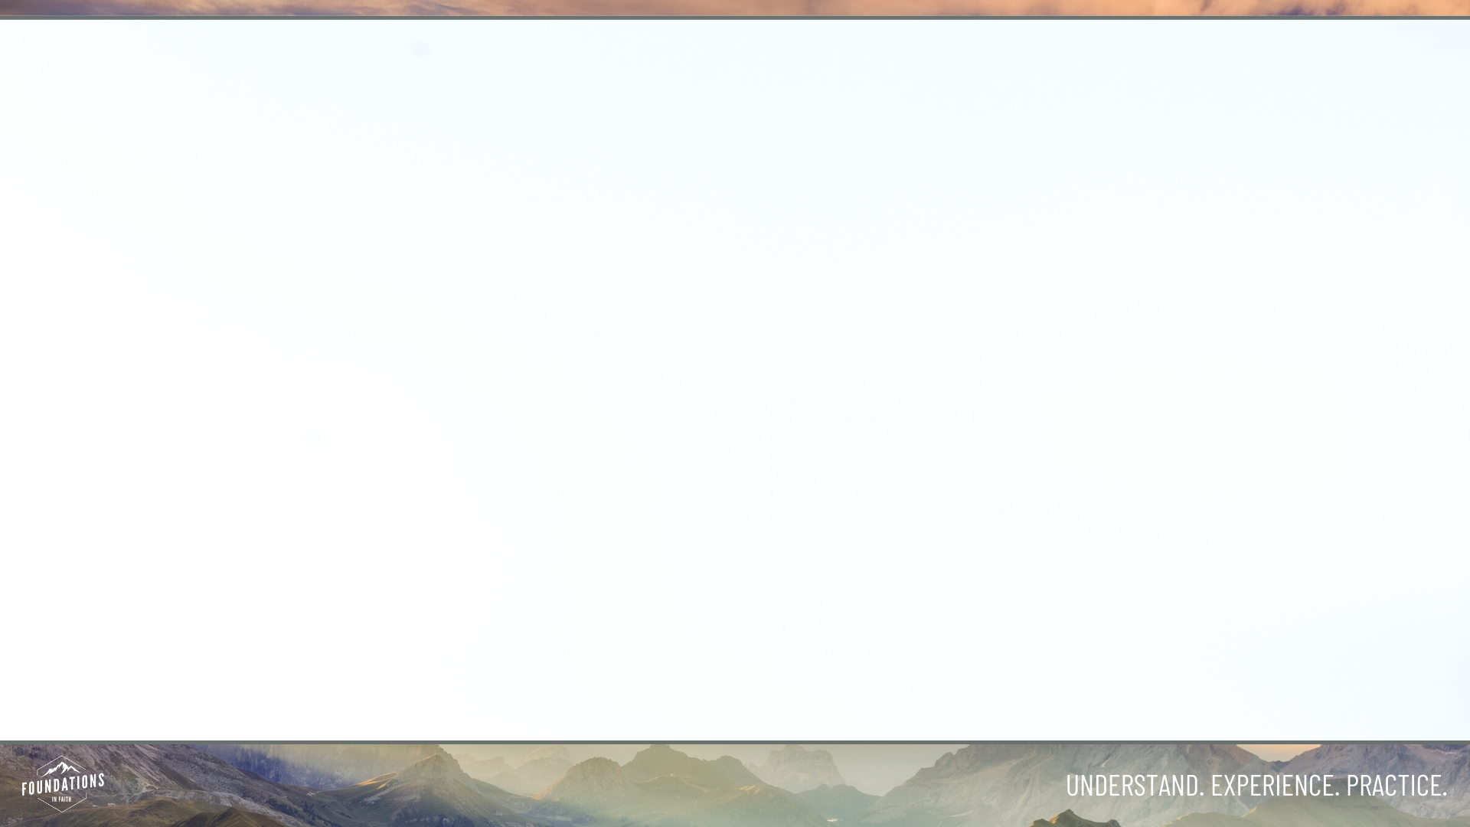
The Lord’s Prayer
    Our Father, who art in heaven, hallowed be Thy Name.
    Thy Kingdom come, Thy will be done
    on earth, as it is in heaven.
    Give us this day our daily bread.
    And forgive us our trespasses, as we forgive those who have trespassed against us.
    And lead us not into temptation, but deliver us from evil.
    For Thine is the kingdom, and the power, and the glory, for ever and ever.
    Amen.

Slide 3
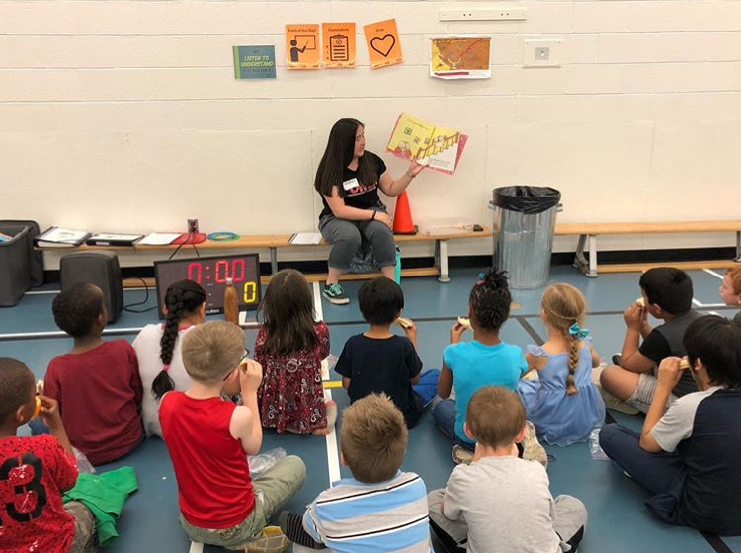
Discuss: How Did It Go Last Week?
Outside our church:
  Local Ministries Opportunities
    -see separate handout
Within our church:
  Kids ministry
  Greeting Team
  Join Missions
  Add items to our Sukkah bins
Notes:
Glenn and Shirley served with Kids min and did GREAT!;

Slide 4
Song: This I Believe (The Creed)
By Hillsong Music, 2014
The song lyrics are the words of the Apostles’ Creed
The Apostles’ Creed wasn’t written by the disciples of Jesus. Came about in the 3rd century, and affirms the truths of the New Testament.
The Apostles’ Creed has been used as a succinct way to affirm biblical truths about the Christian faith.

Slide 5
The Body Of Christ
Christ has no body now but yours
No hands, no feet on earth but yours
Yours are the eyes with which he sees
Yours are the fee with which he walks
Yours are the hands with which he blesses all the world
Yours are the hands
Porters Gate: Christ has no Body now but yours.

Slide 6
Discussion #1
Where have you seen Christ hands, feet on display in Central Alberta?

Slide 7
Discussion #2
When you think about the Body of Christ being people who go and are sent by Jesus into the world. How does your life reflect this calling in the following areas:
Being someone who invites and pursues others to join you in life and following Jesus.
Being someone who serves central alberta and the church

Slide 8
Apostles Creed
I believe in God, the Father almighty,
creator of heaven and earth.
I believe in Jesus Christ, his only Son, our Lord.
He was conceived by the power of the Holy Spirit
and born of the virgin Mary.
He suffered under Pontius Pilate,
was crucified, died, and was buried.
He descended to the dead.
On the third day he rose again.
He ascended into heaven,
and is seated at the right hand of the Father.
He will come again to judge the living and the dead.
I believe in the Holy Spirit,
the holy catholic Church,
the communion of the saints,
the forgiveness of sins,
the resurrection of the body,
and the life everlasting. Amen.

Slide 9
Discussion #3
Where do you find yourself having to fight for unity?
Any believer or group of believers you need to forgive to maintain unity?

Slide 10
Discussion #4
Where have you experienced being built up by the body? Where have you built up the body?

Slide 11
Putting It Into Practice
Find a place to serve & tell us about it.
Find a place to participate in community, join a small group, start a small group, pursue someone from foundations or church to invite into relationship.
If you are doing both of the above, the next step is asking who you could bring along to join you on that journey.

Slide 12
Doxology: Expression of Praise to God
Praise God from Whom all blessings flow.
Praise Him all creatures here below.
Praise Him above ye heavenly hosts.
Praise Father, Son and Holy Ghost.
Amen.

