Slide 1


Slide 2
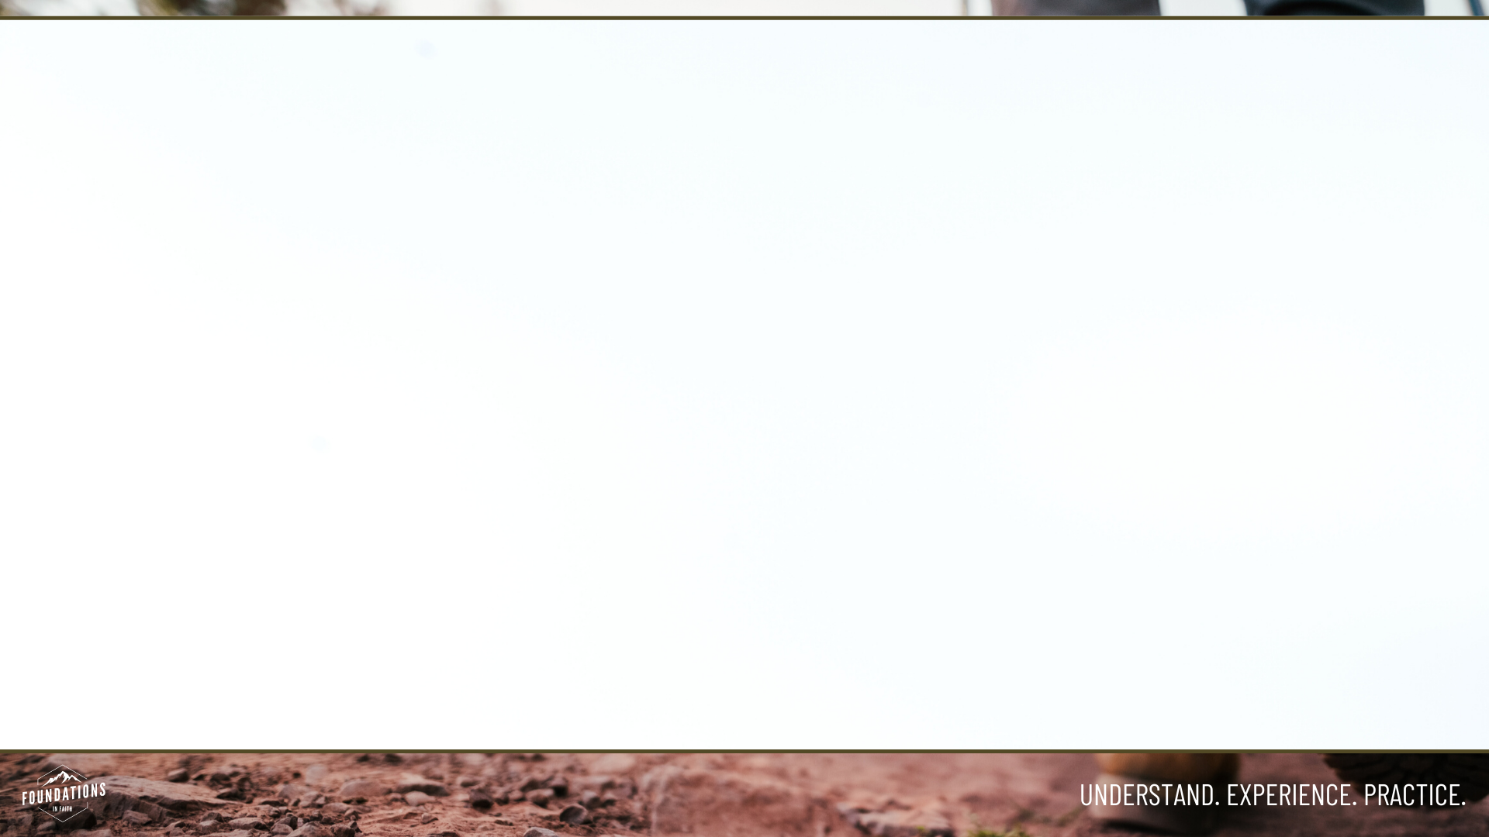
The Lord’s Prayer
    Our Father, who art in heaven, hallowed be Thy Name.
    Thy Kingdom come, Thy will be done
    on earth, as it is in heaven.
    Give us this day our daily bread.
    And forgive us our trespasses, as we forgive those who have trespassed against us.
    And lead us not into temptation, but deliver us from evil.
    For Thine is the kingdom, and the power, and the glory, for ever and ever.
    Amen.

Slide 3
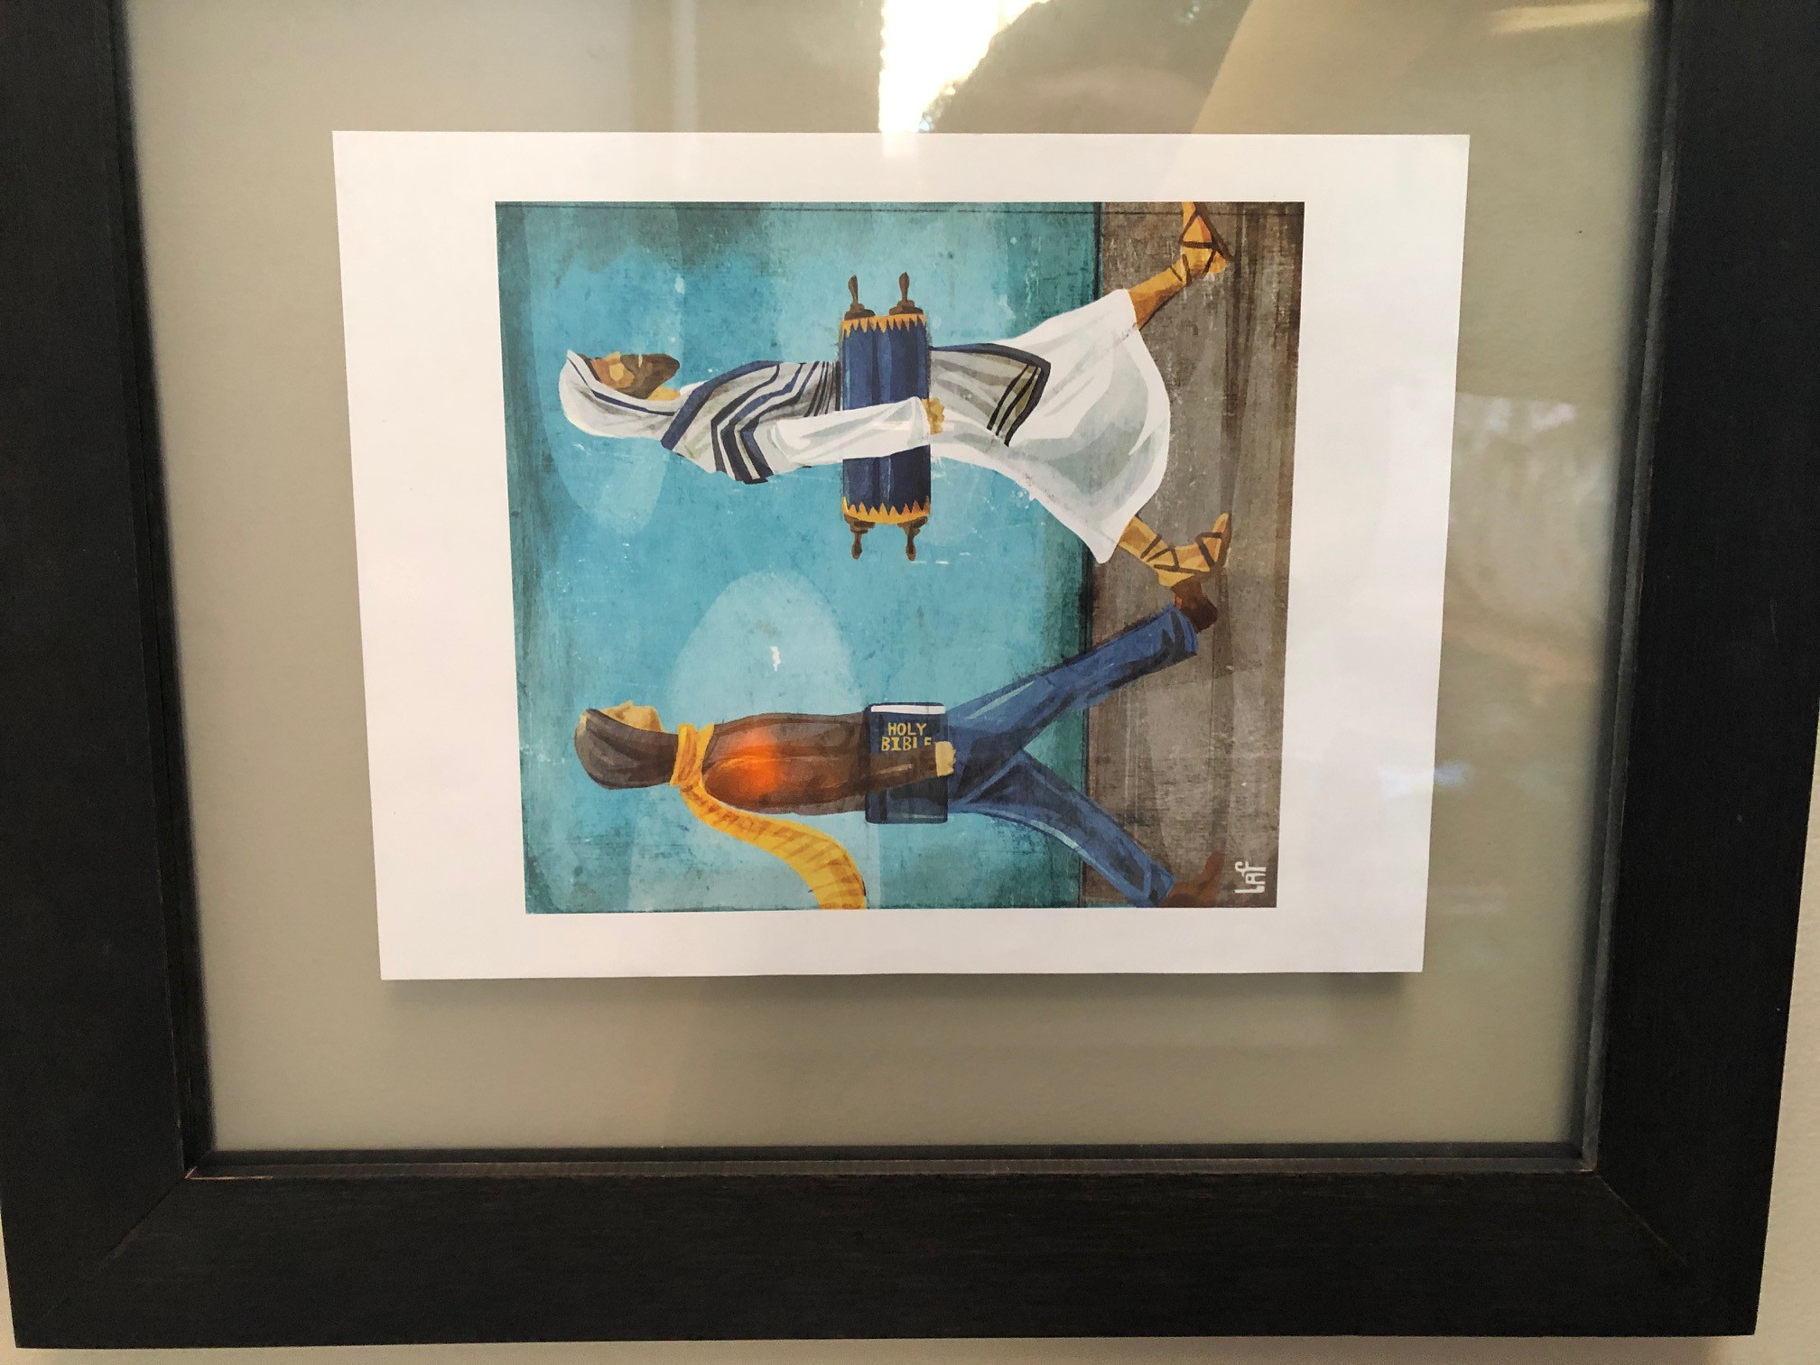
Luke 6:46-49
“Why do you call me, ‘Lord, Lord,’ and do not do what I say? As for everyone who comes to me and hears my words and puts them into practice, I will show you what they are like. They are like a man building a house, who dug down deep and laid the foundation on rock. When a flood came, the torrent struck that house but could not shake it, because it was well built.
But the one who hears my words and does not put them into practice is like a man who built a house on the ground without a foundation. The moment the torrent struck that house, it collapsed and its destruction was complete.”

Slide 4
Song: Jesus, Firm Foundation
Old hymn, published in 1787 by John Rippon
Modern version – the Worship Initiative
Lyrics focused on Jesus as the truth we stand on, no matter what is going on around us. He defends us, upholds us, and strengthens us.

Slide 5
Discuss
What does it mean to be a disciple?

Slide 6
1. A Disciple Knows God

Slide 7
John 17:1-3
After Jesus said this, he looked toward heaven and prayed:
“Father, the hour has come. Glorify your Son, that your Son may glorify you. For you granted him authority over all people that he might give eternal life to all those you have given him. Now this is eternal life: that they know you, the only true God, and Jesus Christ, whom you have sent. I have brought you glory on earth by finishing the work you gave me to do. And now, Father, glorify me in your presence with the glory I had with you before the world began.
                (Emphasis added)

Slide 8
2. A Disciple Knows God’s Word

Slide 9
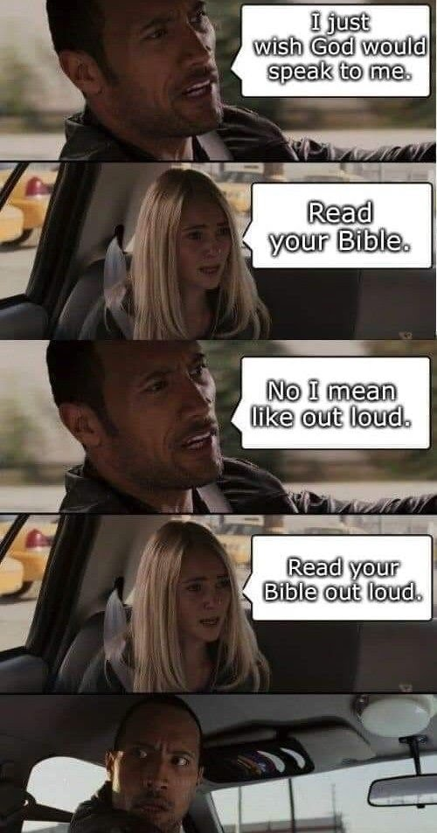

Slide 10
3. A Disciple Acts Like Jesus

Slide 11
1 John 2:6
Whoever claims to live in him must live (walk) as Jesus did.

Slide 12
Deuteronomy 30:11-14
Now what I am commanding you today is not too difficult for you or beyond your reach. It is not up in heaven, so that you have to ask, “Who will ascend into heaven to get it and proclaim it to us so we may obey it?” Nor is it beyond the sea, so that you have to ask, “Who will cross the sea to get it and proclaim it to us so we may obey it?”
No, the word is very near you; it is in your mouth and in your heart so you may obey it.

Slide 13
Galatians 5:22
But the fruit of the Spirit is love, joy, peace, patience, kindness, goodness, faithfulness, gentleness and self-control.

Slide 14
Are We His Disciples?
Is our greatest desire to be like Jesus?
Do we study His Word and hide it in our hearts?
Do we put our faith in action?
Do we walk in His way?

Slide 15
Good News…
He says we can do it!
He helps us through the power of the Holy Spirit
He forgives us when we fail, and helps us get started again

Slide 16
Experience
Discuss together
  What does this look like in your everyday life?

Slide 17
Practice: Building Our Foundation
Pray: Ask God to show you where and how He wants you to grow as His disciple.
Learn God’s Word: This week, consider memorizing Galatians 5:22-25. (If you’re ambitious, consider memorizing Galatians 5:13-26). Depend on the Spirit to help you grow.
Fellowship: Who are you accountable to? Who is accountable to you? We walk together as we follow Jesus.

Slide 18
Doxology: Expression of Praise to God
Praise God from Whom all blessings flow.
Praise Him all creatures here below.
Praise Him above ye heavenly hosts.
Praise Father, Son and Holy Ghost.
Amen.

