Slide 1
Foundations: Serving
Because We Are On Mission

Slide 3
Our Church
We want to give everyone in Central Alberta an opportunity to have a personal relationship with Jesus Christ and by following Him together, impact the world with compassion and hope.
Using Isaiah 58 as a guide, we follow Jesus by:
Loving Each Other Deeply
Serving and encouraging one another.
Giving Priority to the Last, the Lost, the Least, the Little and the Nearly Dead
Sharing what Jesus has done for me.
Praying for God's heart, understanding and direction.
Giving of ourselves and our resources.

Slide 4
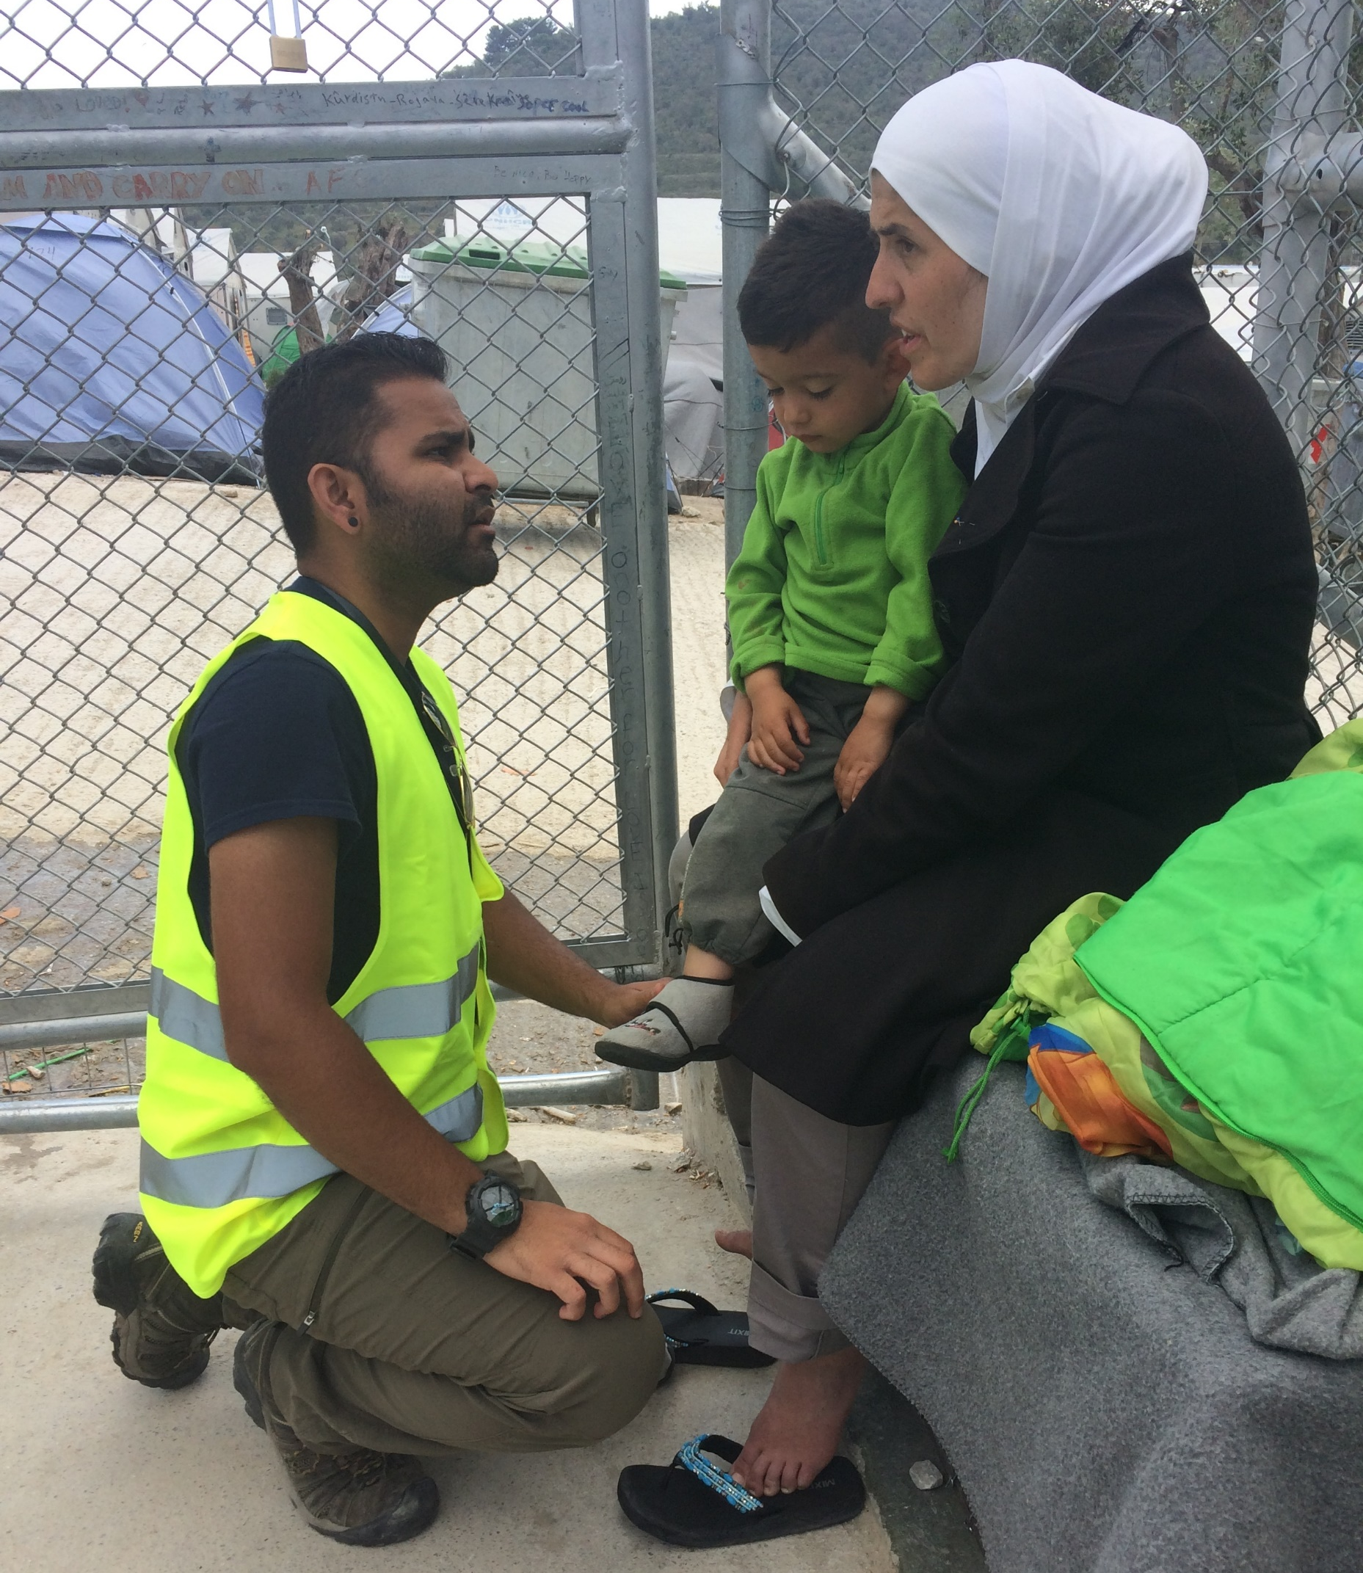
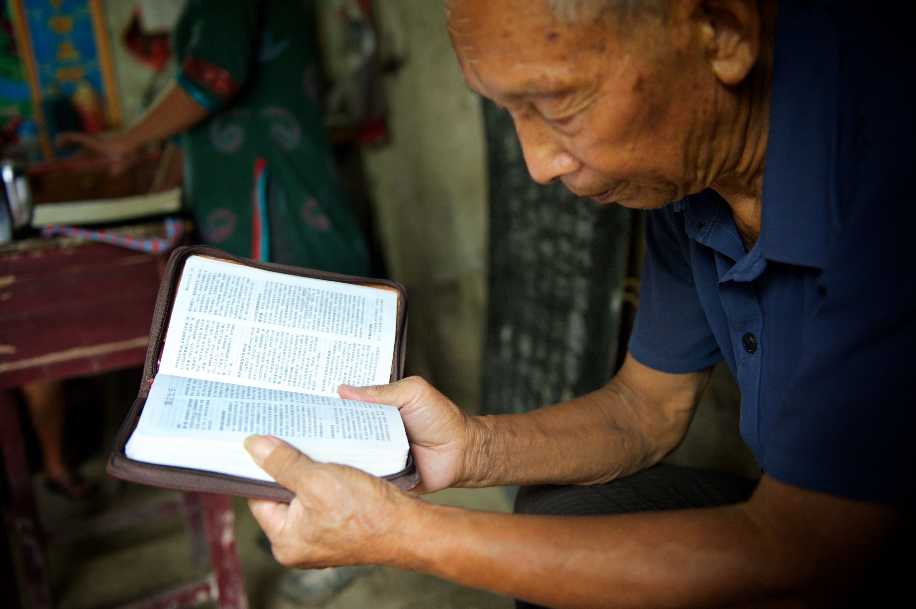
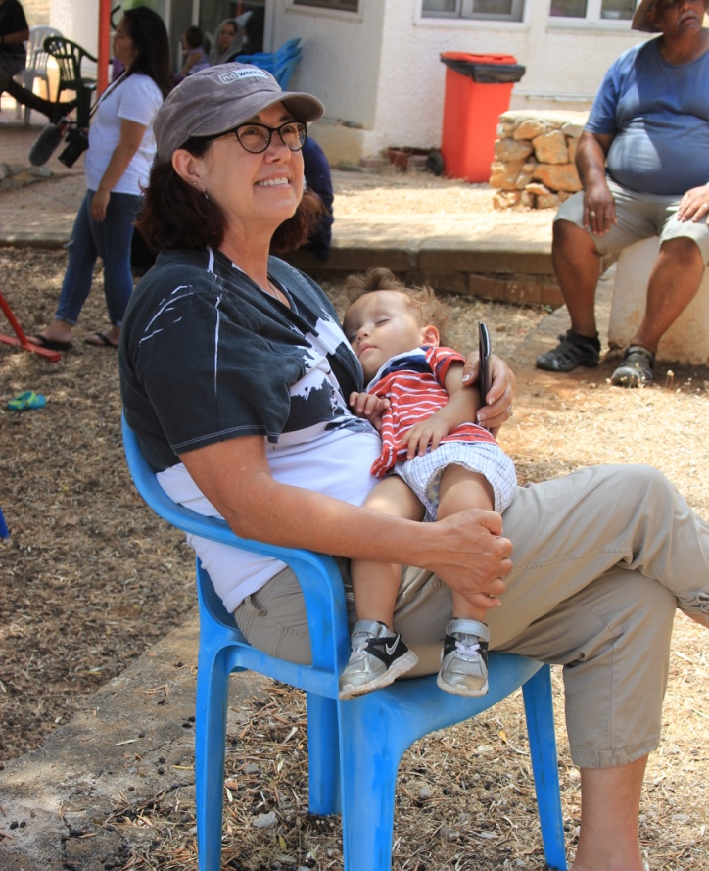
Our Missions Department:
To be a catalyst within CrossRoads Church for living on mission.
We do this as we educate, equip, inspire and engage our people offering compassion, hope and love to the lost and vulnerable,
in Word and deed and through strategic partnerships.

Slide 5
Living On Mission
GOD is a missional God. He is on a rescue mission!
Every 'follower of Jesus' is already assigned as a missionary or to be ‘on mission’ with Him.
2 things for every believer:
-Love God and our neighbors (Matthew 22:37-39)
-Tell people about Jesus (Matthew 28:18-20)
Serving is a great way to do both of these!
Blessed to be a Blessing!

Slide 7
Being On Mission
We don’t pursue a “me, me focus”; we pursue Christ & his Kingdom.
Living out our faith, choosing to sacrifice; intentional with time, $, energy and skills
Looking for specific ways to bring hope (Jesus) to desperate situations
Our work and service is worship and brings glory to God as we offer what we have to him!

Slide 8
Why Do We Serve?
God commanded it: to show the world his love, hope and healing
Jesus modelled it: washing disciples feet, dying for our sins, etc.
Mark 10:45 explains, “For even the Son of Man did not come to be served, but to serve, and to give his life as a ransom for many.”
“Jesus particularly delighted in spreading the good news among the hurting, the weak, and the poor. Hence, it is not surprising that throughout history God’s people have been commanded to follow their King’s footsteps into places of brokenness.” When Helping Hurts

Slide 9
Motivations to Serve
To be part of something noble
To help others
To make a difference
To feel significance
Out of guilt- ‘It’s what I am supposed to do’
To feel good about oneself
Gain points with God or others

Slide 10
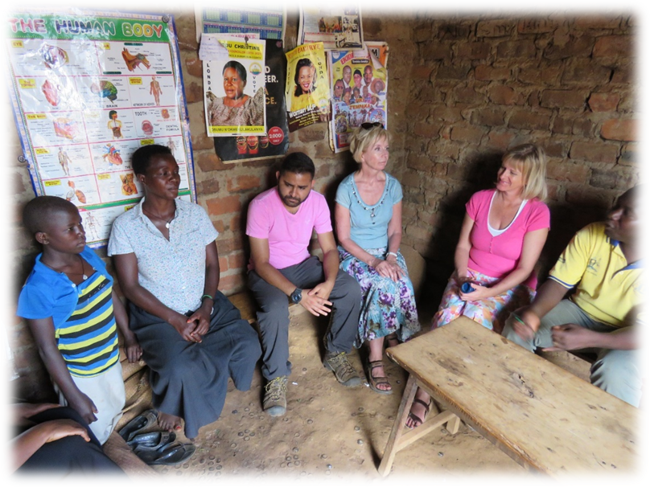
Motivation is Important but so is Our Posture
In the Bible in 2 Cor 9:7 it says to ‘give with a cheerful heart’ not reluctantly or out of pressure or regret.
Helping the less fortunate is beautiful- but can also be dangerous; we can easily hurt those we seek to serve.

Slide 11
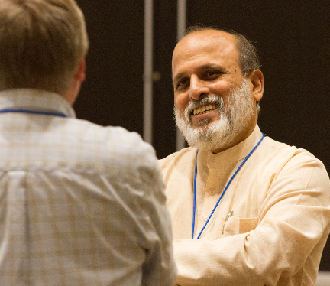
Helping without Hurting – Principle 1
We don’t go to ‘fix’ people or change them; avoid god-complex
Jayakumar Christian (World Vision India Director) speaks on behalf of the majority world,
Have you ever unintentionally reduced poor people to objects or projects that you use to fulfill your own need to accomplish something?
“…the economically rich have ‘god-complexes’ which is a subtle and unconscious sense of superiority in which they believe they have achieved their wealth through their own efforts and that they have been anointed to decide what is best for low-income people, whom they view as inferior to themselves.”

Slide 12
Principle 1(cont)- Avoiding a god-complex
Story of team serving at Loaves and Fishes
Our actions and words towards the materially poor says a lot about our heart.
We help raising feelings of significance & pride and they receive increasing shame & decreases dignity
So, how do we avoid doing this?

Slide 13
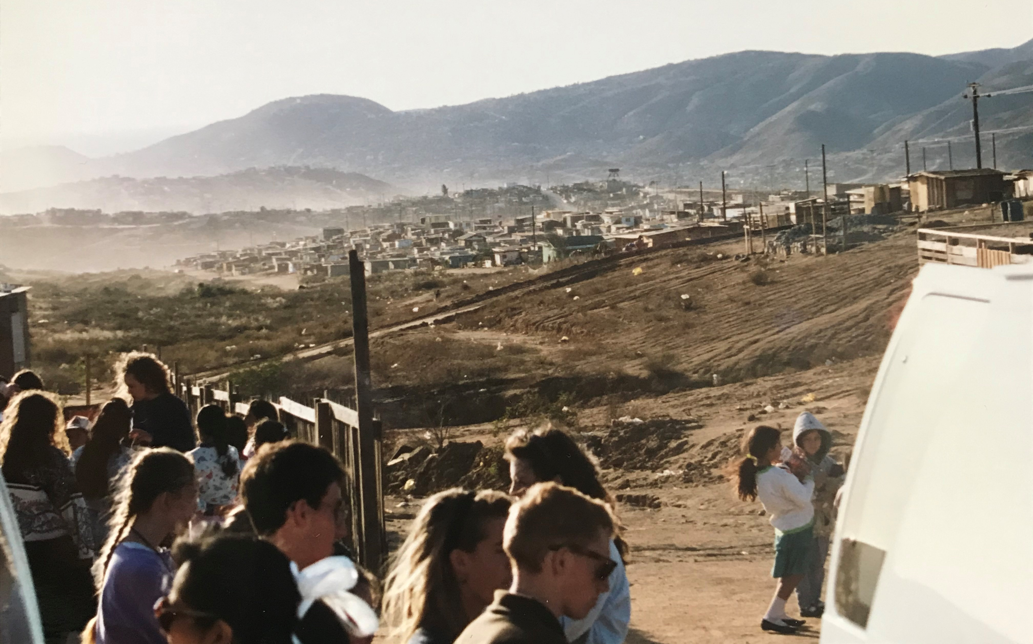
Principle 2- How We See Poverty
How do you define poverty?
Mexico story:
Poverty is complex

Slide 14
A New Way to See Poverty
“Poverty is the result of relationships that do not work, that are not just, that are not for life, that are not harmonious or enjoyable. Poverty is the absence of shalom in all its meanings.”
-Bryant Myers Walking with the Poor
Broken relationships with God, others, self and creation
Who are the poor?

Slide 15
Double-Edged Sword
Material Definition of Poverty
God-complexes of Materially Non-poor
Harm to Both Materially Poor and Non-Poor
Feelings of Inferiority of Materially Poor

Slide 16
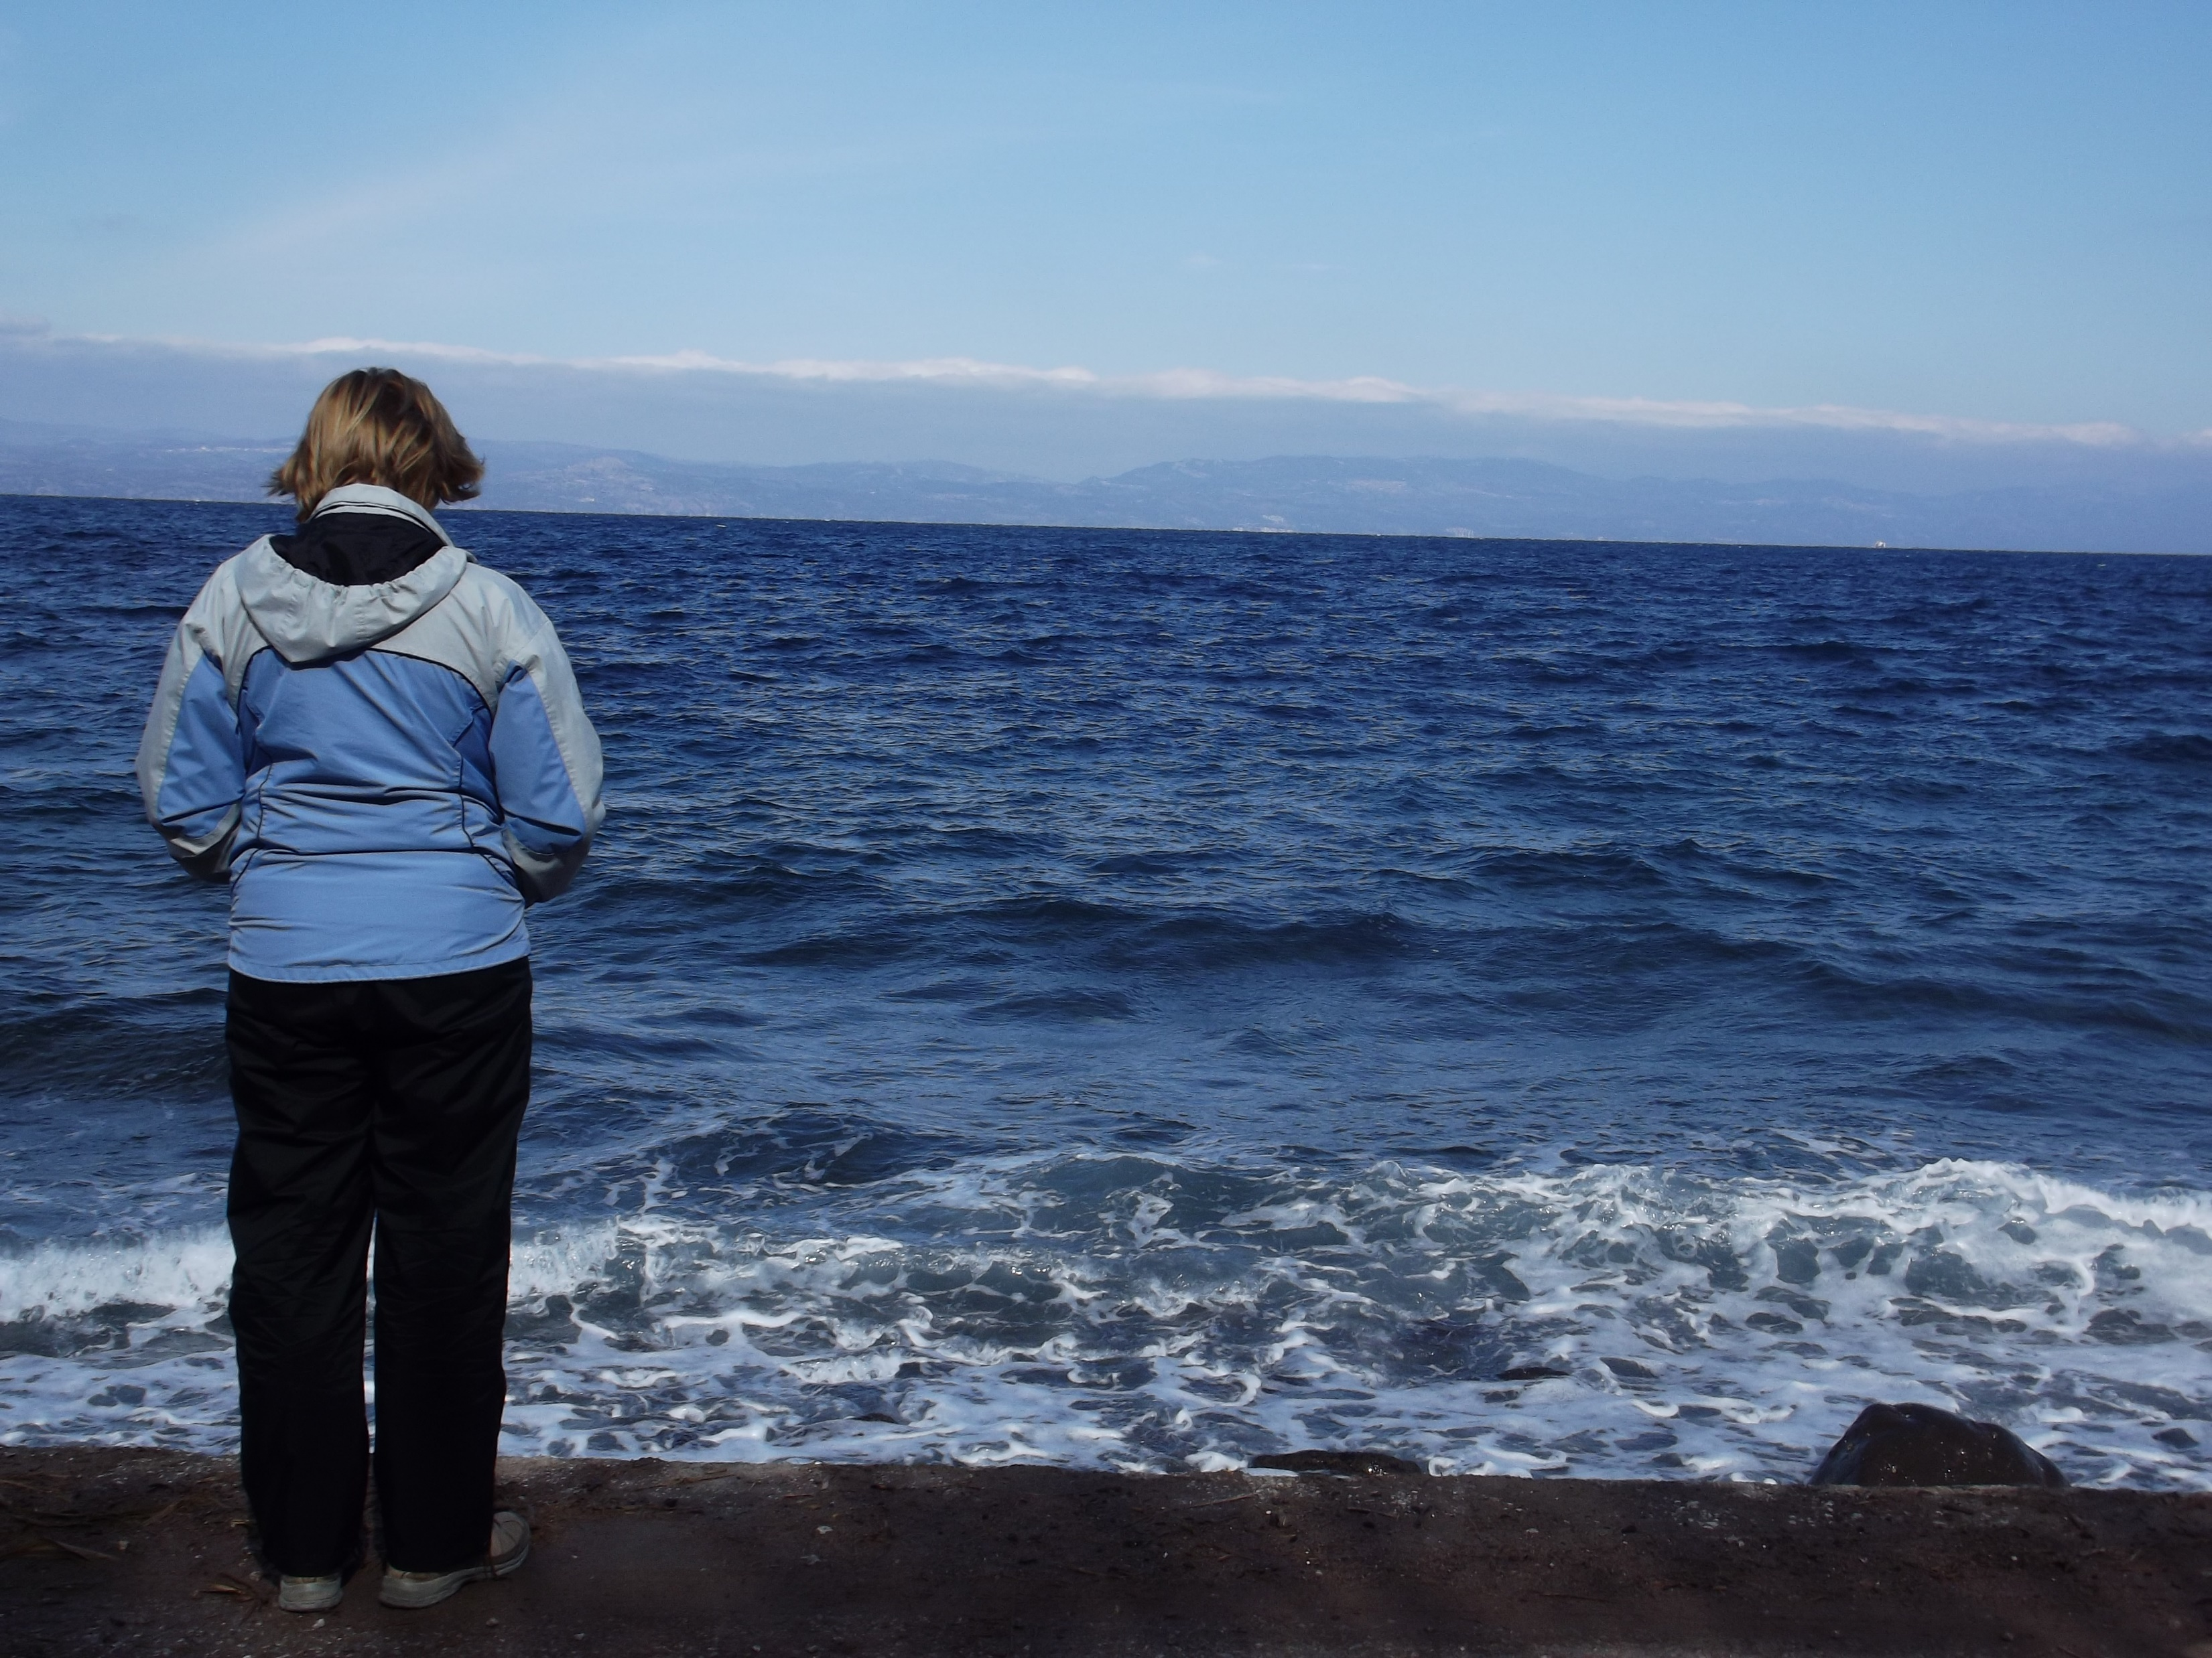
Principle 3 – Who Really Benefits?
God has a great opportunity to shape and changes us!
Go in with open hands, open heart
Story- Laurie in Lesvos
Laurie’s lessons-
Notes:
her preconceived ideas, anger, frustration- she too was broken; the power of giving a smile or simple gesture; recognized she couldn’t fix anything but could be part of the solution; giving her time, getting heart involved was more powerful than giving in the offering plate; she was able to see the people more as God saw them

Slide 17
Remember:
God is on mission and he picked you to be on his team! You are ambassadors SENT by God to SERVE and GLORIFY him by reaching your neighbors, coworkers, family and the world in His name (2 Corinthians 5:20).
What is your part and are you ready to play?
“Each of you should use whatever gift you have received to serve others, as faithful stewards of God’s grace in its various forms.”
--1 Peter 4:10

Slide 18
Discussion Questions:
1) Think of a time when you volunteer, what was your motivation to serve? What was your heart posture when you served?
2) What fear or barriers hold you back from serving?
3) What do you think God’s purpose is for asking us to serve?

Slide 19
Challenges
Red Deer River Clean-Up
-Saturday June 5th (2 hours during 12- 4pm)
-Register as a family unit/cohort via our church webpage
Future Opportunities with Mission partners and initiatives
-see separate handout

